Slide 1



Introduction to algorithms and machine learning
What is machine learning?

Slide 2

Program for today
The birth of the machine
Common vocabulary
Parametric statistics and ML?
Examples of machine learning
Difference between ML and AI?

Slide 3

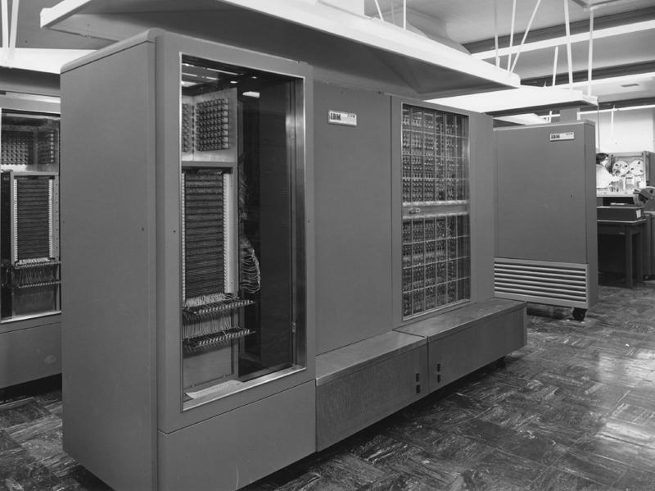


How did we even make it here?
IBM 704 - 1954
Nokia 3210 - 1999
iPhone 11 - 2019
Fugaku - 2021
10.000 FLOPS
25 mill. FLOPS
806 bill. FLOPS
442 quadrillion FLOPS

Slide 4
IBM 704 vs. Fugaku
Fugaku is 442 billion times faster than IBM 704, but what does it even mean to us?
Why does computer speed mean anything to us?
More importantly, why does it change the way we understand the social world?

Slide 5

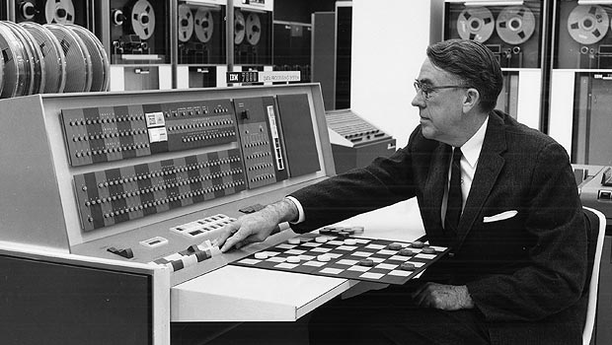
Birth of the machine – foundations of ML
The term ”machine learning” coined in 1950 by Arthur Samuel (IBM) when he developed the first autonomous model to play checkers that learned not just the combined number of board states but learned the actual game by playing

Slide 6
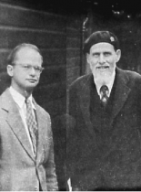
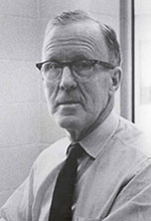
Birth of the machine – foundations of ML
Before Samuel, some were already thinking about the difference between the human mind and how mathematical models worked
Pitts and McCulloch described the first mathematical model with a general idea of ”learning neurons” in 1943
Hebb described how human behavior could be explained by ”neural networks” in 1949

Slide 7
Birth of the machine – where are we now?
We have made models that are able to beat the best chess players in chess (1996), Jeopardy (2011) and Go (2016)
We have made machines that are better at seeing than human beings (2015)
We have made autonomous cars (2018)
We have even been able to make:
https://www.youtube.com/watch?v=WXuK6gekU1Y
An interesting documentary about machine learning and the game ”Go”

Slide 8

ANJA-TRUMP!

Slide 9
Common vocabulary (let’s cut the bullshit)
Most of you here already know what words are ”hot”
Data driven
Data science
Big data
AI
Machine learning
Algorithms
Deep learning
But what are the commonalities and the dependencies when talking about there concepts?

Slide 10
Common vocabulary – the basics
Before diving into different aspects of machine learning, we need to define the somewhat ambigous words on the list and also my least favorite ones since they are the ones that are least precise. These concepts are:
Data science
Big data
Data driven

Slide 11
Big data driven data science?
Data science, accordning to IBM, encompasses: ”Preparing data for analysis and processing, performing advanced data analysis, and presenting the results to reveal patterns and enable stakeholders to draw informed conclusions.”
Right, so how is that different than any type of scientific method and especially statistics? The short answer: ”It’s not”. The long answer is, that data science revolves around the first part; preparing data of ANY kind for analysis
What is big data then? In the 90’s, size was the main aspect but now, big data is defined by either one of three categories; high volume, high velocity or high variety
What does data driven mean? It means everything and nothing and I care very little about it

Slide 12
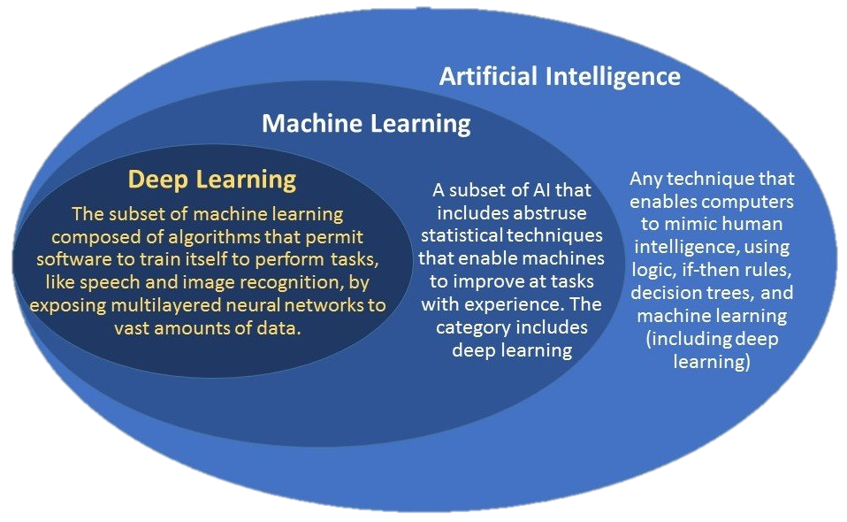
AI, ML and Deep learning

Slide 13
Birth of the machine – as an answer to?
Until the middle of the last century, mathematics and statistics had given us answers to most of the questions we had
Gosset made the t-test as an answer to how the chemical composition of small samples of barley was (for brewing Guiness)
In general, parametric models gave us the answers we sought after:
What is the correlation between X and Y?
How strong is the correlation between X and Y?
How big is the difference in Y given X?

Slide 14
Word of warning
The following slides revolve around a way of thinking ML and statistics with an example of multiple OLS regression
While there are no direct errors in what is to come, some of the information has been simplified to accommodate the arguments and to help the listener understand the general differences
Many ML models use OLS differently and thus, this example just speaks about the differences in a general way and not a specific one

Slide 15

Difference between classical statistics and ML - With linear regression as an example
The classical multiple OLS regression seeks to understand how Y changes given a set of independent variables (X);
$$Y=β_{0}+β_{1}X_{1}+β_{2}X_{2}+ …+β_{k}X_{k}+ε$$
Linear regression is used widely in machine learning models as well and the equation looks as following:
$$Y=β_{0}+β_{1}X_{1}+β_{2}X_{2}+ …+β_{k}X_{k}+ε$$
Confused yet?

Slide 16
Difference between classical statistics and ML - With linear regression as an example
The primary ”qualitative” difference between the to approaches is the questions we wish to answer
Are the question:
”What is the correlation between Y and these other variables?”
Or:
”How effective can I predict Y given this set of variables?”

Slide 17
Difference between classical statistics and ML - With linear regression as an example
The way a machine learning model solves the problem is very different from the way a statistical program solves the problem
In statistics, the problem is solved when the OLS equation has minimized the sum of the squares of the difference between the observed dependent variable and those predicted by the linear function
In ML, the problem is solved by combining, splitting, weighting and doing all sorts of stuff to the independent variables so that the prediction becomes as strong as possible

Slide 18
Difference between classical statistics and ML - With linear regression as an example
Thus, the concept of generalization and statistical inference becomes much less important in ML-models
We don’t care about the input data or how each of our inputs individually has an effect of Y, we care about how well the combined model can predict a specific value of Y
Simply put, most of it is somewhat brute force – instead of us thinking about specific connection (perhaps these variables have an interaction, or these have a non-linear co-effect) ML tries all of them in a lot of combinations and learns what works while trying random stuff

Slide 19
Different types of ML and how they work
As stated earlier, a somewhat easy way of categorizing ML models are by stating if they are unsupervised or supervised
Supervised models can learn by knowing the answer to some of the data (using labeled data) and using that to learn in what way to use this information to give future predictions
Unsupervised models don’t know the answer to anything but seeks to minimize/maximize whatever element we give it in the best way possible
The consensus is that supervised models are fancier that unsupervised – I disagree and talk a bit about why a little later

Slide 20
Supervised and unsupervised ML
Unsupervised ML includes (but are not limited to):
Cluster analysis
Anomaly detection
Association mining
Autoencoders
Supervised ML includes (but are not limited to):
Support Vector Machines
Decision trees
Random forests
Neural networks

Slide 21
Unsupervised ML What is the goal?
Roughly put, the goal in most unsupervised learning is to reduce complexity of data (structured and unstructured)
We have no absolute goal of making an algorithm that predicts stuff well, but we want to understand and group our data better
Our questions can revolve around topics like:
How can we group these values?
What is ”rare” or an anomaly given this large set of data?
What sequence often occurs given a set of values?

Slide 22
Supervised ML What is the goal?
In supervised ML the spectrum is broader but the goal more concise; precision
We have a clear question for our computer, and it could be something like:
What is it in influencers photos that results in many likes?
Who shows especially aggressive behavior towards ethnic minorities on Twitter?
Who are the individuals with the largest probability of dropping out of university?

Slide 23
Supervised and unsupervised ML
Unsupervised models are often more coarse and are less specific to a given problem – they are agressively good at strukturing data and finding patterns but they are less good at finding something specific WE want to find
Supervised models are more finely tuned – we can ask them very specific questions and we can teach them what is correct and what is incorrect because we can impose our general idea of what it should look for – not in detail but with a result of some sort
In supervised models, how do we actually teach them stuff?

Slide 24
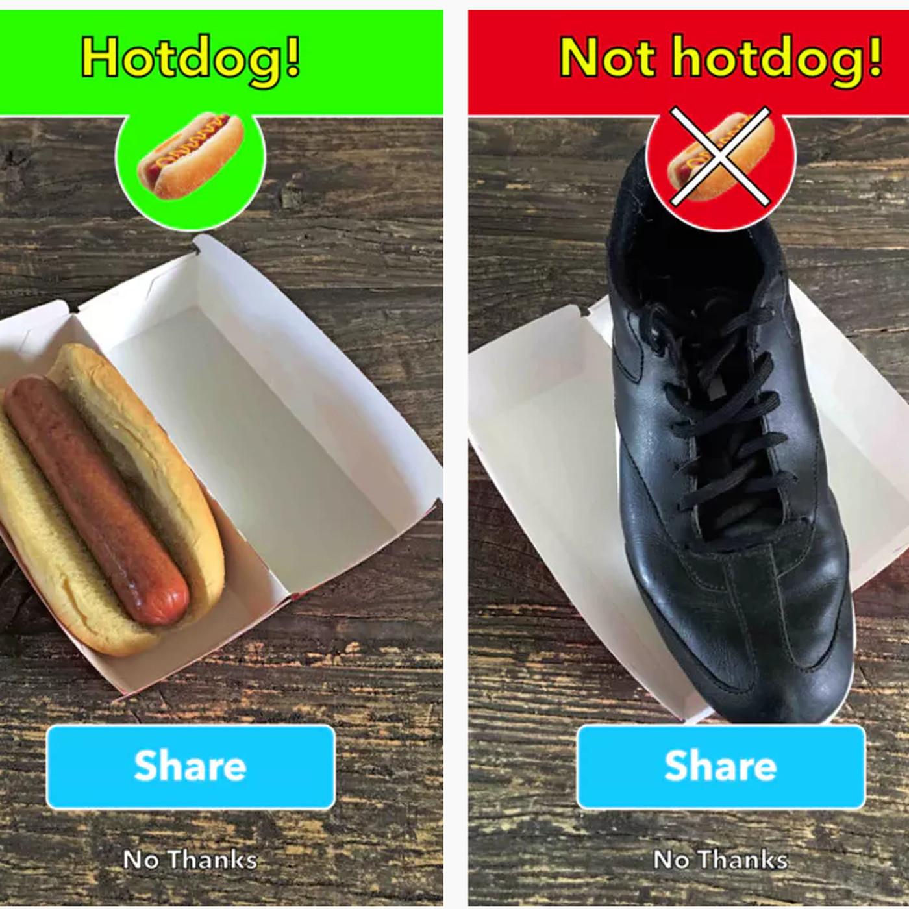
How?
We have students label thousands of images, tables or whatever data we need to investigate
This is not a joke – we need someone to label data, or we need data that have some labels
Why do you think the CAPTCHA-test is implemented everywhere? Human labelers for free!
As humans, we know which one is a hotdog, but a computer does not
Fun fact, CAPTCHA stands for: Completely Automated Public Turing test to tell Computers and Humans Apart

Slide 25
A picture says a 1000 words
While having labeled data is a prerequisite, this is not enough on its own – we need a model to test if our model works on “unseen” data
Why? Because machine learning is ridiculously well equipped to learn, they might “overlearn” in what we have shown them – this is called overfitting (and this is one of many problems we might encounter)
Overfitting is the result of the algorithm learning too much from what we have shown it to use the model to say anything about other data – it knows our dataset and predicts it perfectly, but it knows nothing about everything else
”Going off a tangent”-time!
ANOTHER PROBLEM IS ”SNEAKY AI”

Slide 26
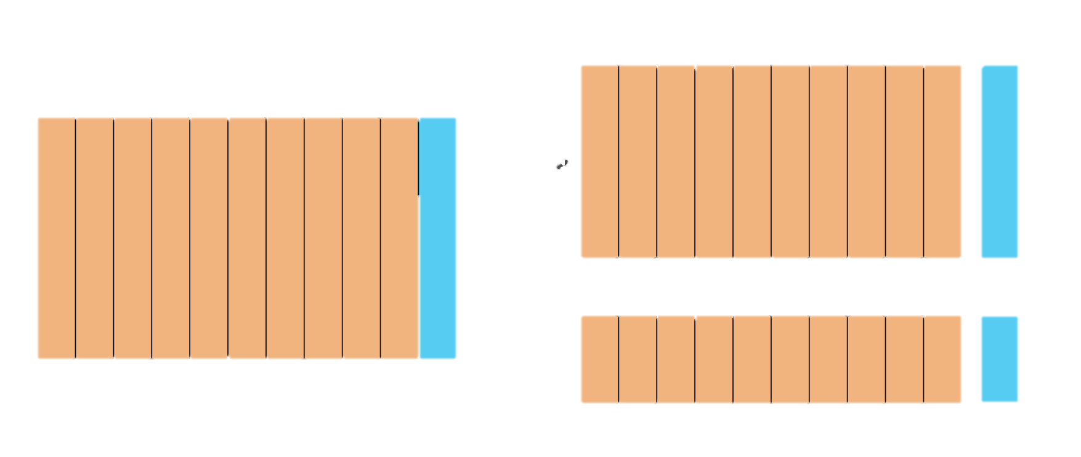
Train/test-split
To help the model and to identify problems, almost all supervised learning uses what is know as a train/test-split of the data
In praxis, this means our data is split in 2; training data and test data. All of this data is known data; we have labels on the data and we know if the machine is right, but it is only shown answers in the training data
When running a model, the model will (this is a general model, so steps might vary immensely but this is a reduced form):
Look at the input and make a random guess
Check how the guess predicted the label
Change something in the input
Run the model again
Check how the guess predicted the label
Keep going at this for a very long time (or just very, very fast)
This step is called backpropagation

Slide 27
Train/test-split
When this is done and some parameter we have decided is met (either how good the model is or how many times it has tried), it stops learning new things and tests how well it predicts unseen objects in the test data. Why is this clever? Because now we know how well the model works with “new” data
If the model works well with the known data (train data) but poorly with unknown data (test-data), we know something is up and we need to find a remedy

Slide 28
In short – what is machine learning?
Machine learning is the task of getting a computer to learn known or unknown parts of out data to reproduce or find specific traits
The way machine learning differs most from classical statistics is partly defined by what we want to solve and partly by how these methods solve the question; how much is the user involved?
Now one last thing; what is the difference between machine learning and deep learning?

Slide 29
Deep learning
Deep learning is a type of machine learning that can solve very complex problems and learn very complex things
To illustrate, I will show you a neural network architecture and then a deep neural net:

Slide 30
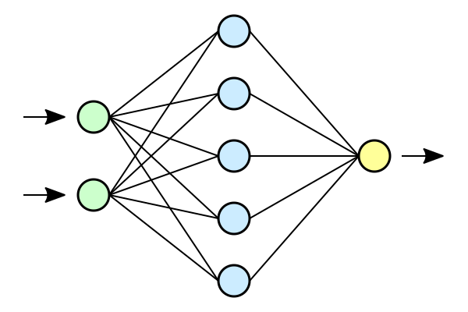
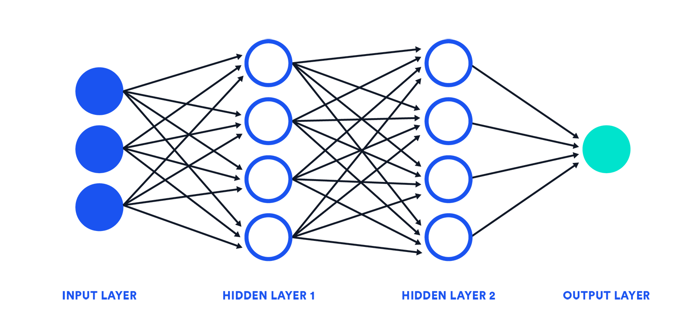
Deep learning
Neural network
Deep neural network

Slide 31
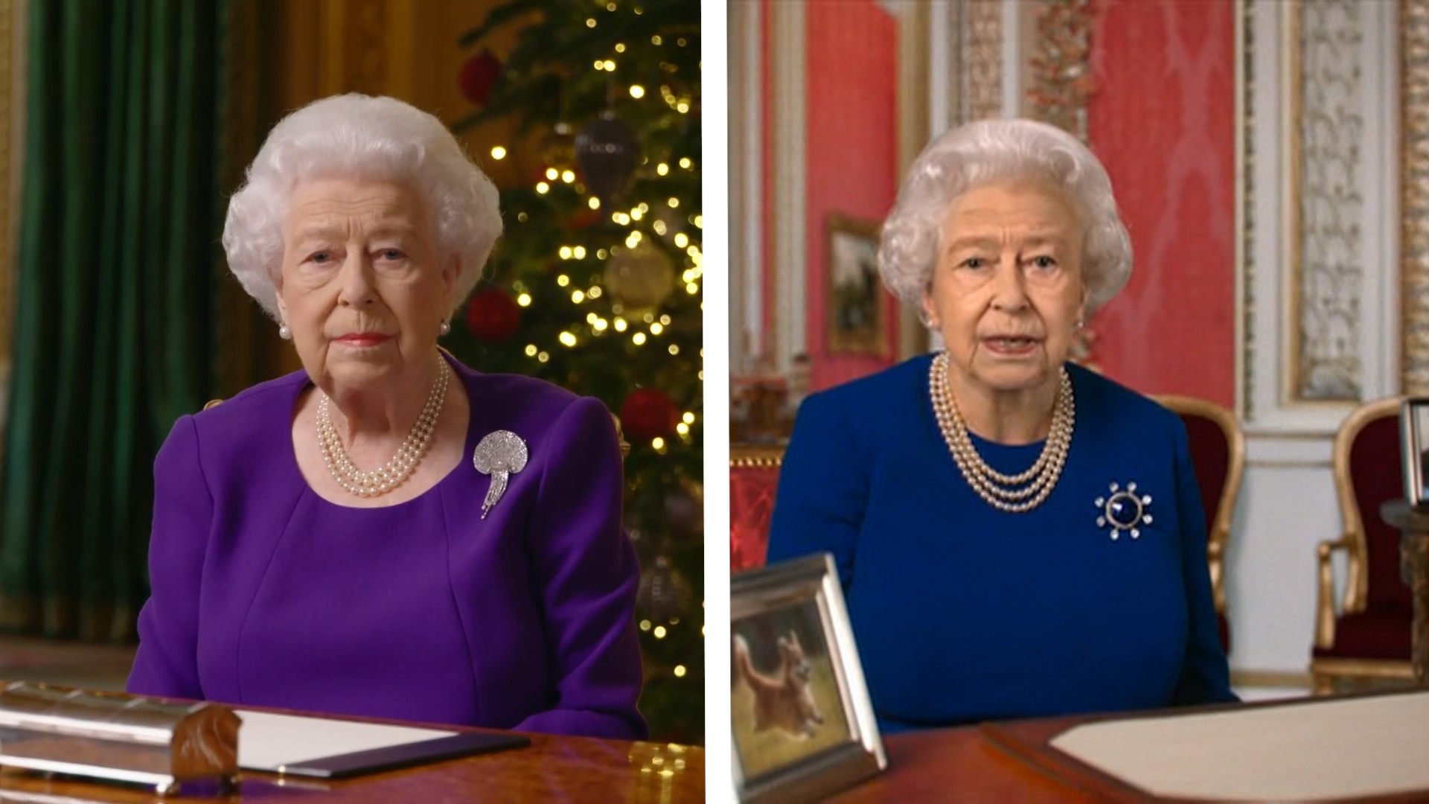
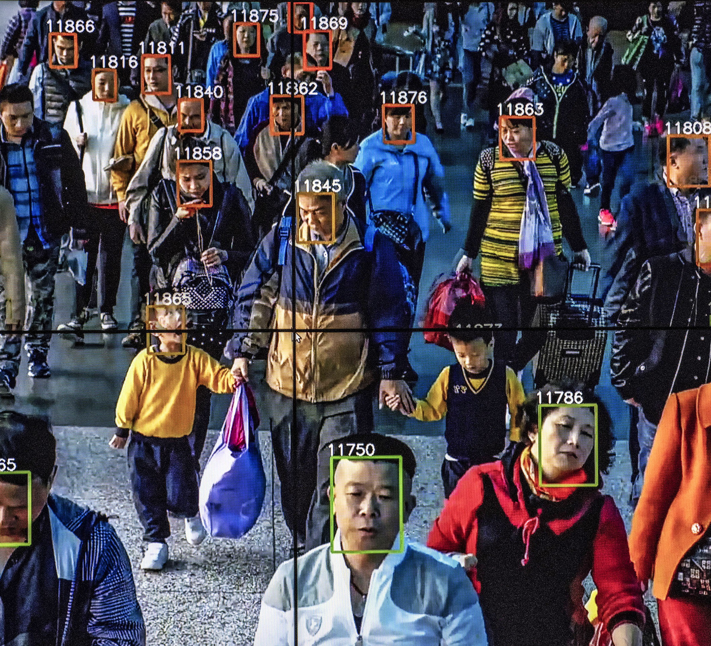
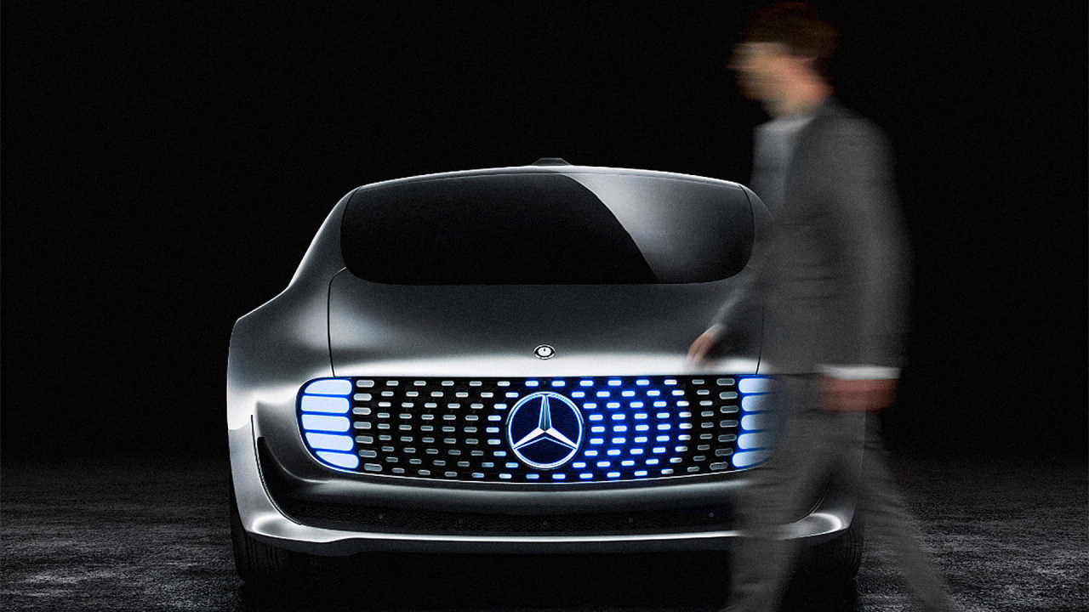
Examples from now – a dystopian remix
Not the real queen
AAU – delivers the goods
Always kills the pedestrian!

